Slide 1

Event Processing Course
Lecture one –
Introduction
(relates to chapters 1 and 2)

Slide 2



The motto of this course
Focus on emerging technology
Dive deep inside
Internalize and retain over time

Slide 3
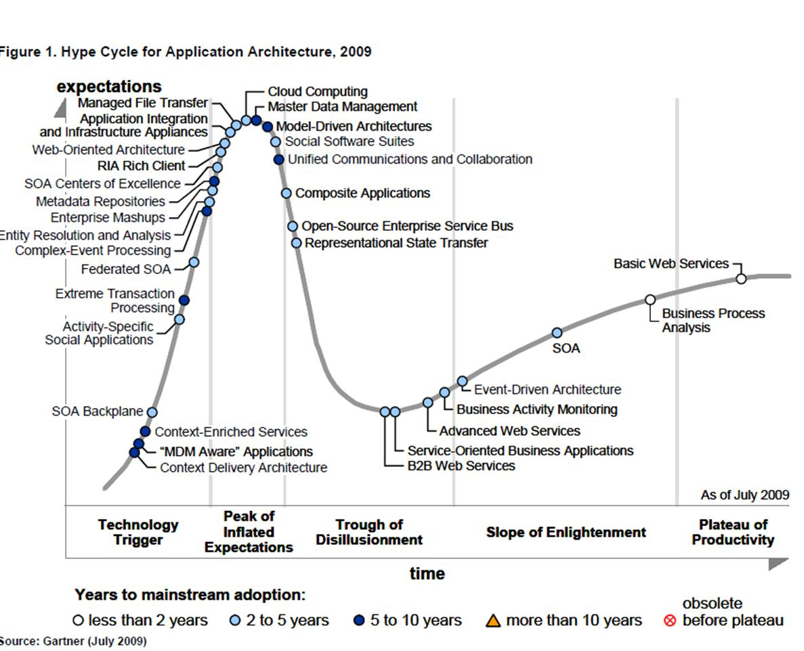
Emerging technologies in enterprise computing
(Gartner Hype Cycle, Summer 2009)

Slide 4




Dive deep

Slide 5

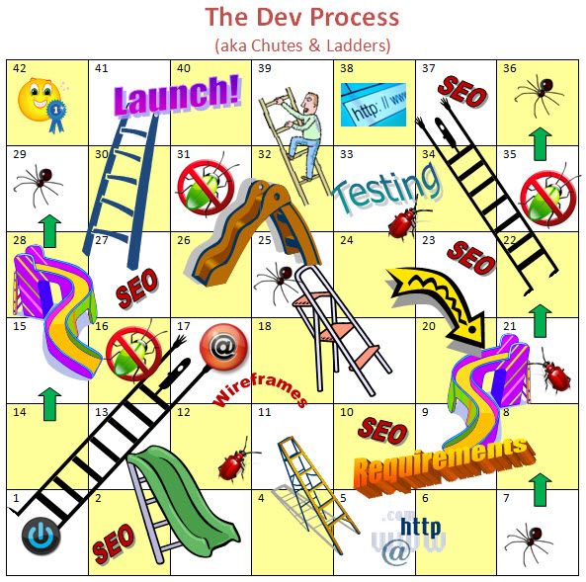
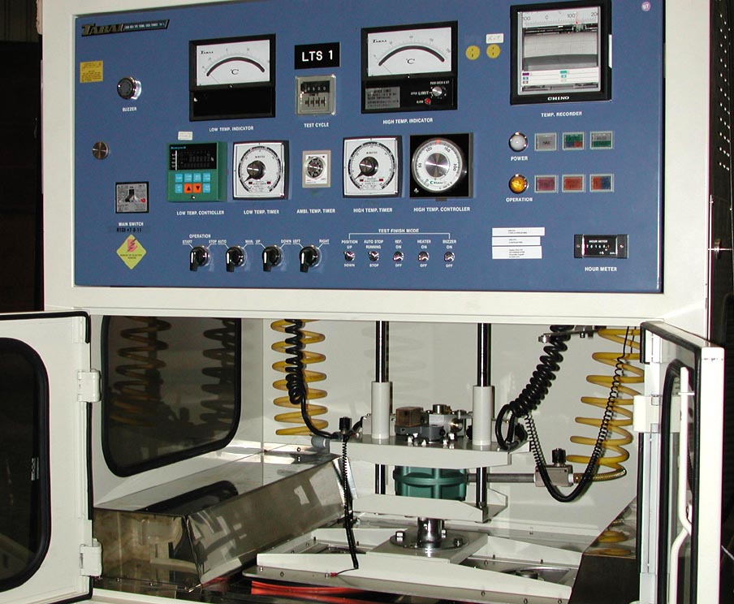
Internalize by:
Experiment
Application
Developer
View
Product
Developer
View

Slide 6
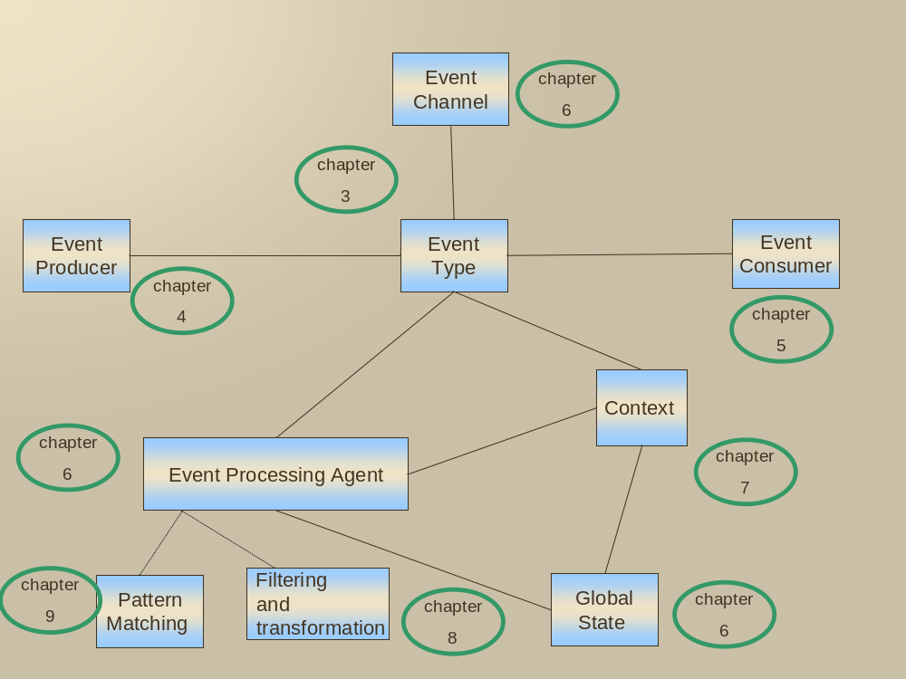
PART 1:
ENTRY POINT
Entry point
Chapter
1
Architectural
and programming
Principles
Chapter
2
PART 2:
THE BUILDING
BLOCKS
Engineering and
implementation
considerations
PART 3:
ADDITIONAL
TOPICS
Challenging topics
Emerging directions
Chapter
11
Chapter
12
Chapter
10

Slide 7
Lecture outline
The notion of event
Event-driven computing
Event processing and its positioning in IT enterprise computing
Event-driven architecture
Model driven approach and major building blocks
The FFD example

Slide 8
Event and situation
An event is an occurrence within a particular system or domain;
it is something that has happened, or is contemplated as having happened
in that domain.
The word event is also used to mean a programming entity that
represents such an occurrence in a computing system.
A situation is an event occurrence that might require a reaction

Slide 9



The fast food alternatives

Slide 10
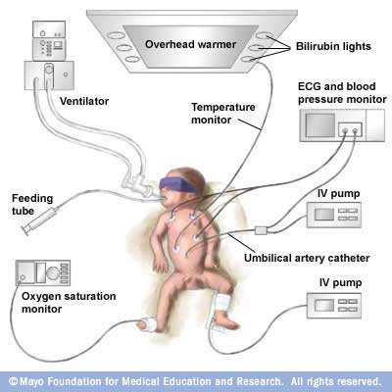


Example 1:
Smart healthcare – Preterm Infants
Patient is hooked up to multiple monitors (in hospital or at home) - the physician can set up event- based rules on multiple measurements and patient’s history when to send an alert and to whom:
Defined
Pattern

Slide 11

Example 2: RFID on luggage
THE LUGGAGE PERSPECTIVE:
Across the 24 largest airlines more than 5.6 million bags went missing in 2006, this is an average of 15.7 bags per 1,000 travelers. 15% of the bags are never found.
BBC News, April 4, 2007
Orchestrate: Passenger has been re-routed to another destination – send the luggage
Notify:
Bag has been checked but did not reach the ULD within 20 minutes
Notify: Bag has been checked but did not reach the connecting flight
Orchestrate:
Bag has reached to the wrong aircraft

Slide 12
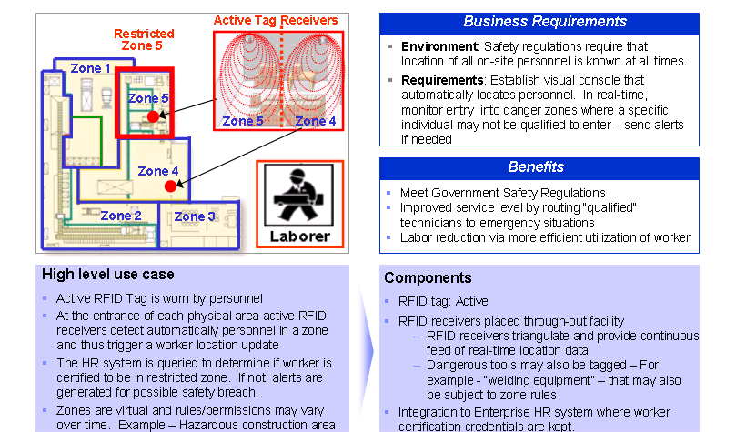
Example 3: Safety zone management
Notes:
Done with Websphere RFID Premises Server and AMiT

Slide 13


Example 4: Alerts in banking
Bank Account alerts;
Weekly withdrawals are more than X
Balance is less than y
My investment portfolio is up z% since the start of the week

Slide 14



Example 5: Fraud detection

Slide 15













Example 6 – Emergency first responders
(presented by Dieter Gawlick from Oracle in the 4th event processing symposium)
ABC Chemicals
County Office
Hospital
Notification Message
Fire Station
Fire Station

Slide 16




Example 7 – fairness in trading

Slide 17

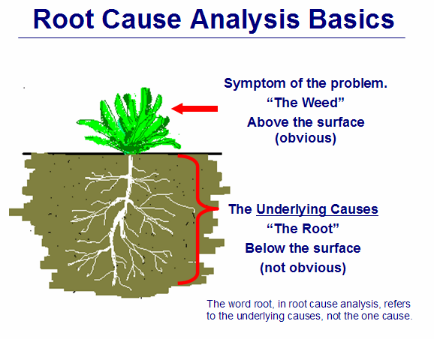
Example 8 - Diagnostics: root cause analysis of failure

Slide 18

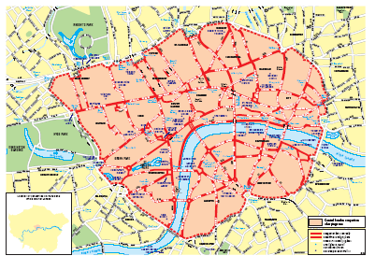

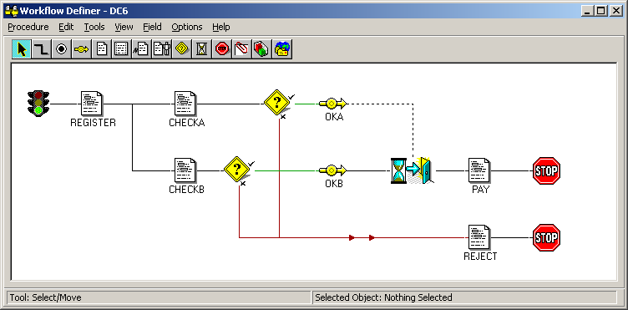

Example 9 – the cameras in London
Billing
Car
DB
Car Theft

Slide 19


Example 10: Presence in social network
5 members are online

Slide 20
Event processing
Event Processing is computing that performs operations on events. Common event processing
operations include reading, creating, transforming and deleting events.
Specific properties of event processing
Abstraction—The operations that form the event processing logic can be separated out from the application logic, allowing them to be modified without having to change the producing and consuming applications.
Decoupling—the events detected and produced by one particular application can be consumed and acted on by completely different applications. There’s no need for producing and consuming applications to be aware of each others’ existence, and they may be distributed anywhere in the world. An event emitted by a single producing application can be acted on by many consuming applications. Conversely you can arrange for an application to consume events produced by many different producing applications.
Real-world focus—event processing frequently deals with events that occur, or could occur, in the real world.

Slide 21
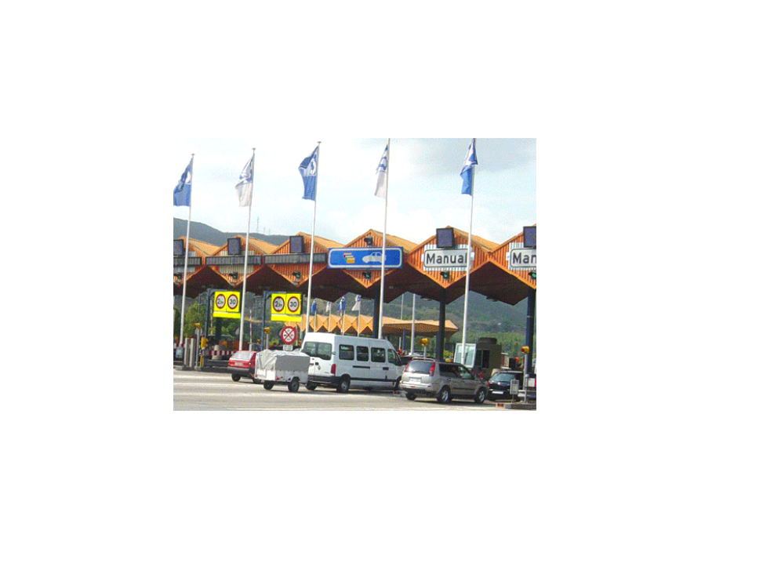

Deterministic and approximate event processing
TOLL VILOATOR
FRUSTRATED CUSTOMER

Slide 22
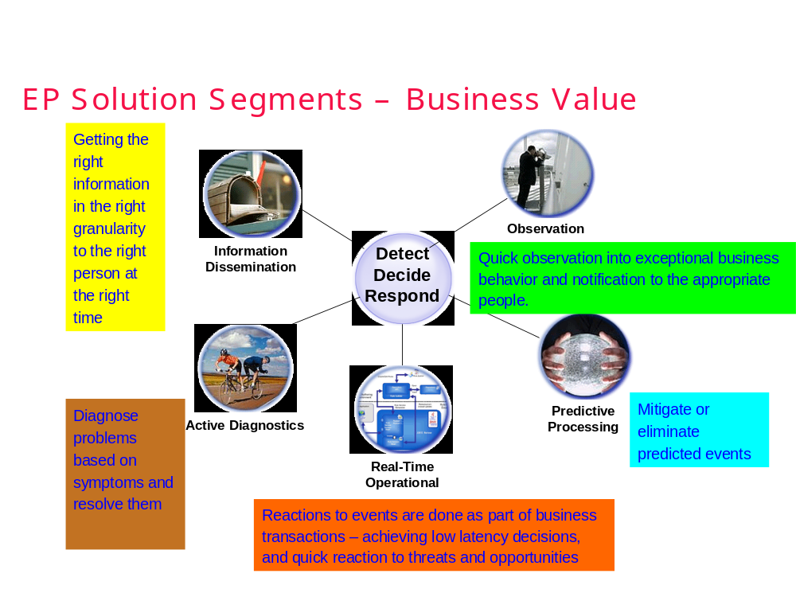
Different types of event processing

Slide 23
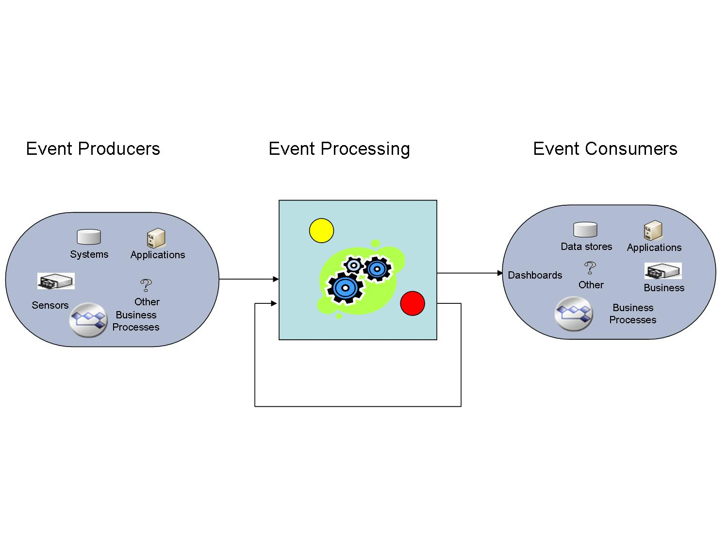
Main parts of event processing system

Slide 24
Event processing – reasons for use specialized tools
There are many event centric applications
Total Cost of Ownership – like DBMS vs. hand coding with file systems, higher programming abstractions -----→ lower cost of development, easier changes, thus lower cost of maintenance.
Implementations geared towards scalability

Slide 25
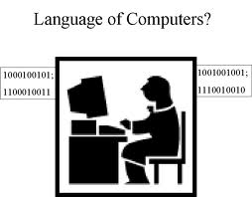
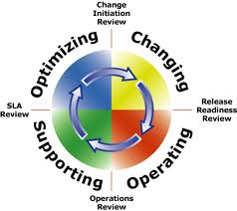
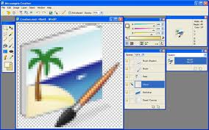
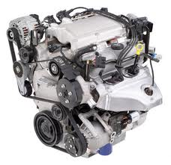
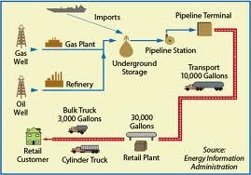
Components of event processing platform
Language
Design tools
Operational management tools
Run-time execution engine
Event distribution mechanism

Slide 26
Event processing positioning
BPM:
Can serve as consumer and producer.
Some BPM products have ad-hoc EP capabilities.
BRMS:
Often confusion between the two.
Differences: state processing vs. transition history processing.
Possible synergies:
BRMS as consumer: An action for an event can be rule flow.
Rules are used for some EP functionality, e.g. routing
BRMS systems can be producers of events
Event-driven contexts can serve BRMS
Patterns from event processing can be used for cross-state reasoning.
BAM:
Typically has built-in limited EP capabilities (mostly aggregations for KPI tracking).
Two BAM trends:
Moving from KPI to more observation types;
Moving from batch observations to some on-line
BI:
Event-driven BI is still relatively minor, but the area of “operational intelligence” is event-driven and on-line

Slide 27
Event processing positioning (cont).
Network and Systems Management:
Event-driven but concentrated in limited aspects:
Event correlation to find the root cause of a problem.
Stream computing:
Streams are types of data that are not necessarily express events – audio, signal, video… Some overlap on “event stream” --- various positioning throughout the industry.
Message oriented middleware:
Event may be expressed as message – but not every message has event semantics
Partial overlap in functionality – especially ESB deals with: validation, enrichment, transformation and routing.

Slide 28









Fast Flower Delivery
Location Service
Bid System
Delivery Request
Location
Bid Request
GPS Location
Store
Preferences
Ranked drivers / automatic assignment
Delivery Bid
Manual Assignment
Assignment
Assignment System
Flower Store
Assignments,
Bid alerts, Assign Alerts
Van Driver
Pick Up confirmation
Delivery
confirmation
Ranking and Reporting
System
Assignments,
Pick Up Alert
Delivery Alert
Driver’s Guild
Control System
Ranking and reports

Slide 29
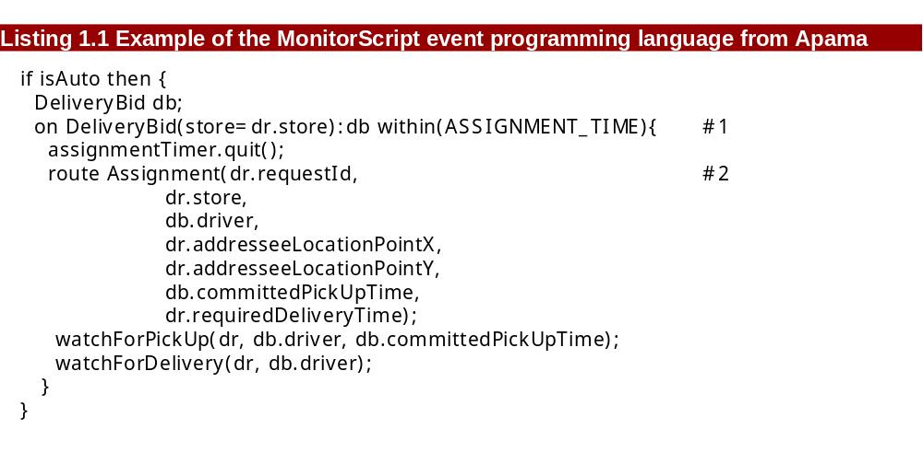
Example of script language

Slide 30
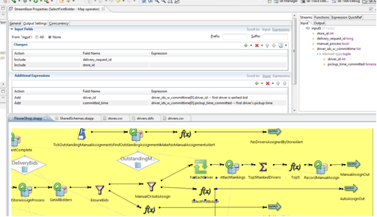
Example of graphical language

Slide 31
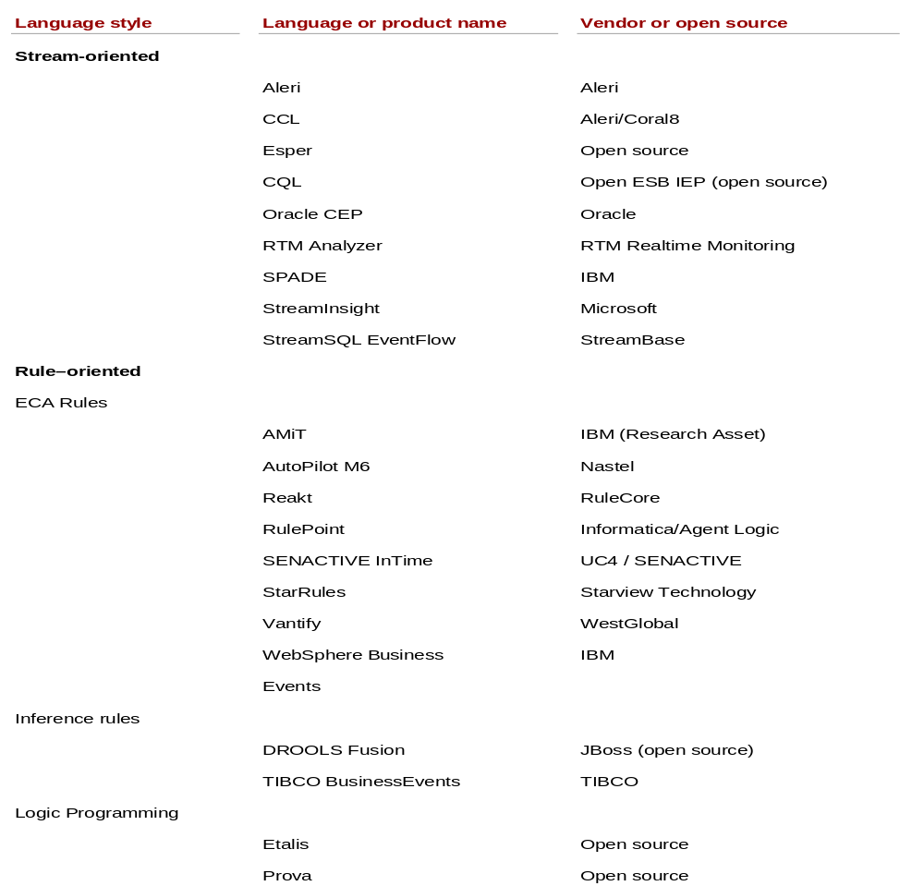
Languages

Slide 32
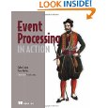
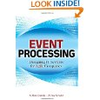

References - books
The course’s text book
A book covering the business side of EP
The first book in this area

Slide 33
References – Websites
The book’s website: http://www.ep-ts.com/EventProcessingInAction
Portal with forum and community Blogs: http://www.complexevents.com/
EPTS: http://ep-ts.com
DEBS conferences.
LinkedIn groups, Twitter, Facebook.

Slide 34
Lecture Summary
In this lecture we have discussed the following topics:
  The notion of event
  Event-driven computing
  Event processing and its positioning in IT enterprise computing
  Event-driven architecture
  Model driven approach and major building blocks

